Slide 1

Twitter’s Role in an Increasingly Polarized Political Climate
Leanne Kendall
Advisor: Dr. Suhong Li
Editorial Reviewer: Dr. Ramesh Mohan

Slide 2
Agenda
Literature Review
Scope & Process
Conclusions
Analysis

Slide 3
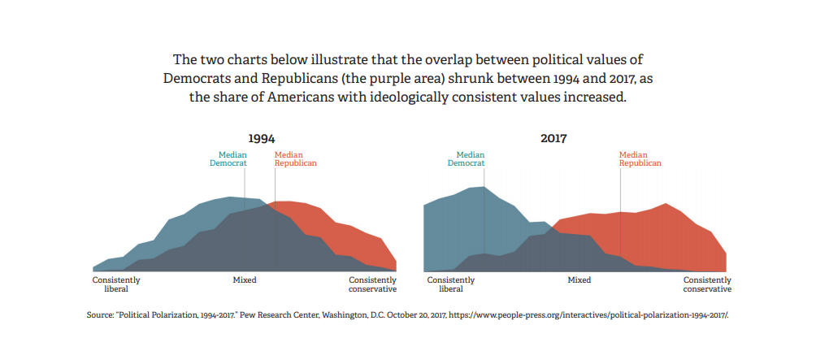
Current Political Environment
Notes:
https://www.themantle.com/arts-and-culture/black-panther-displays-utopia-seeking-close-polarization-gap

Slide 4
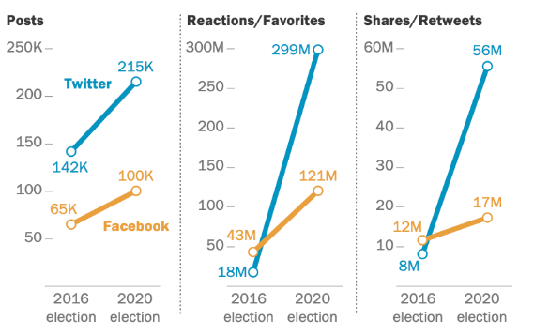
Social Media’s Increasing Presence in Political Campaigns
Total number of interactions on posts from members of Congress on Facebook and Twitter during the 2016 and 2020 elections
Source: Pew Research Center (2021)
Notes:
Figure 1 demonstrates the increased use of social media during elections from 2016 to 2020. There were more posts by members of Congress on both Twitter and Facebook, as well as an increase in reactions, favorites, shares, and retweets on both platforms. The figure shows that Tweets by lawmakers received far greater engagement during the 2020 election than in 2016. There were more 1561% more favorites and 700% more retweets on Twitter in the 2020 election. Social media has become increasingly popular in general over the past few years along with the rise in technology. The increased presence of social media in politics has a big impact on elections. People are exposed to information through social media. This use of social media during elections has increased the polarization between the parties, partially due to microtargeting and misinformation.

Slide 5
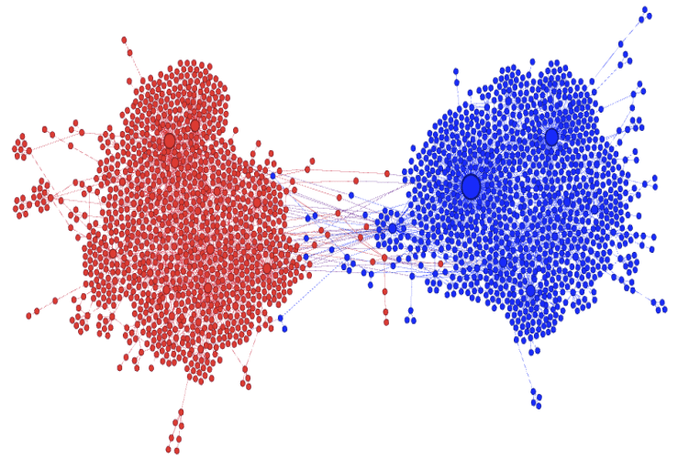
Algorithms Lead to Echo Chambers and Microtargeting
Retweet Graph of Controversial Beef Ban Topic
Notes:
Figure 2 is a visual representation of the echo chambers that form on social media. Hence the name “echo chambers”, the graph shows how two communities engage with their own members and rarely engage with members of the other community. This is how opinions voiced on social media contribute to political polarization. Members of one community are surrounded by opinions that they agree with, resulting in a “group think” effect (Kumar, Jiang, Jung, & Luo, 2018).

Slide 6
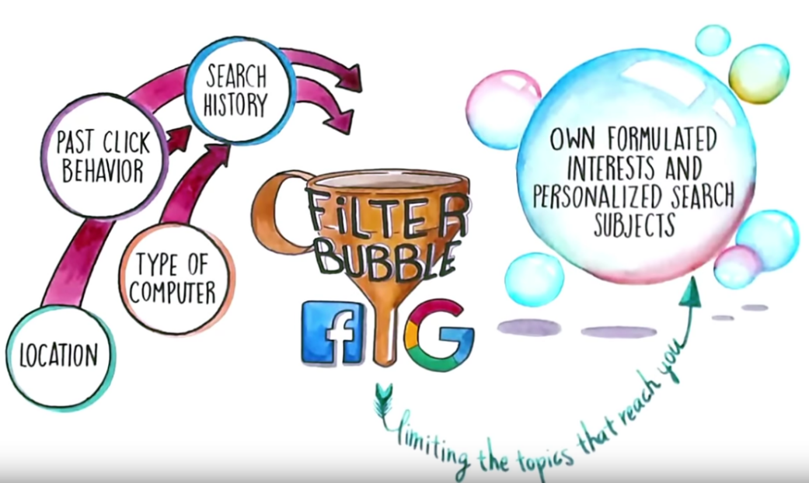
Echo Chambers & Filter Bubbles
Echo Chamber Effects:
Like-Minded Communities
Increasingly homogenous information
Strengthened (more polarized) Views
Notes:
Echo Chamber Phenomenon:
Groups of like-minded people form and avoid difficult or divergent discussions yet willingly discuss—and therefore strengthen—their similar views. file:///C:/Users/student/Downloads/IO1_M8_Unit_8.1._Presentation_ExemplarsGuideToTheInternet_EN.pdf

Slide 7
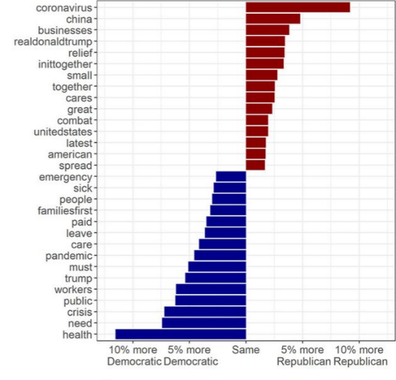
Disparity in Political Language Online
Absolute Difference in Word Use by Party
Source: ScienceAdvances
Notes:
We see a large disparity in the topics talked about by republicans and democrats, suggesting the gap between the parties exists on social media as well.

Slide 8
Effects of Political Polarization in the US
We’re segregated in our own communities – residential communities are becoming more and more politically homogeneous.
Our political culture is more and more antagonistic – campaigns are more negative and focus more on tearing opponents down than building themselves up.
Our families are being undermined – families that cross political parties are seeing shorter dinners and less cross-partisan discourse.
We’re losing trust in key institutions – higher education institutions, the press, the military, libraries, and other institutions are becoming less trusted.
Violence – Hate crimes have risen since the 2016 elections. We have also seen violent politically-driven crimes in recent years.

Slide 9
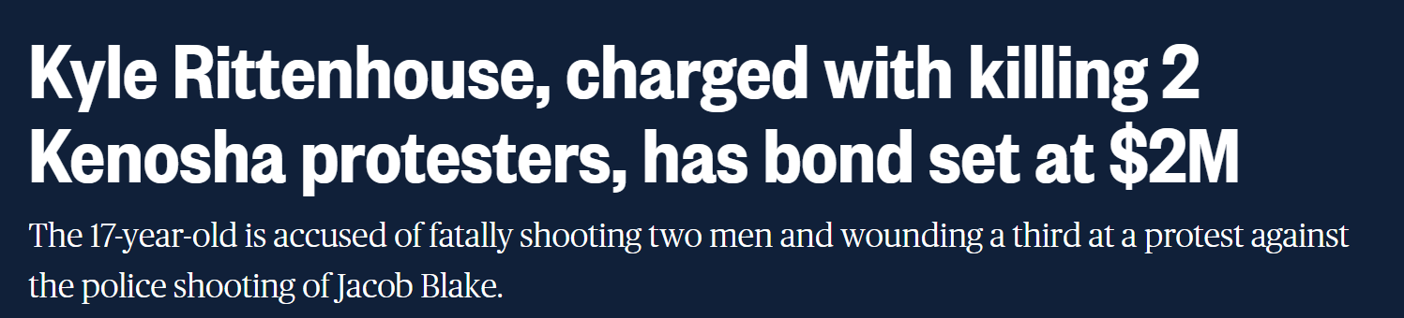
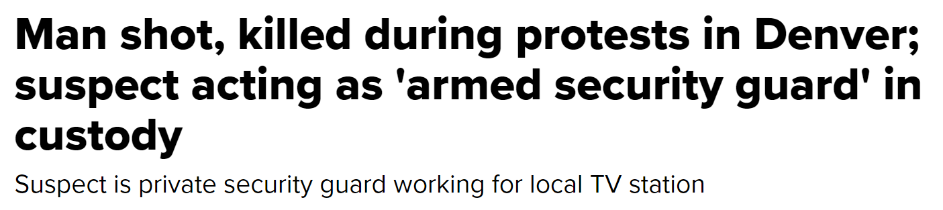
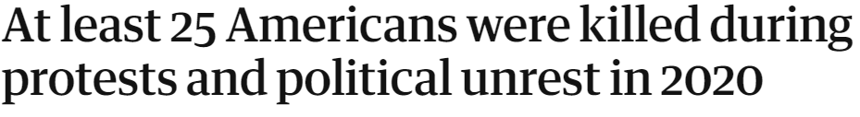
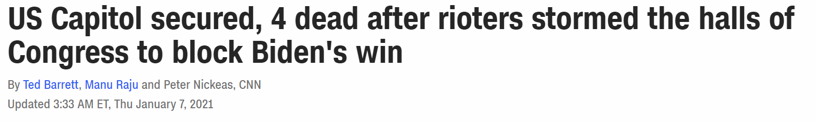
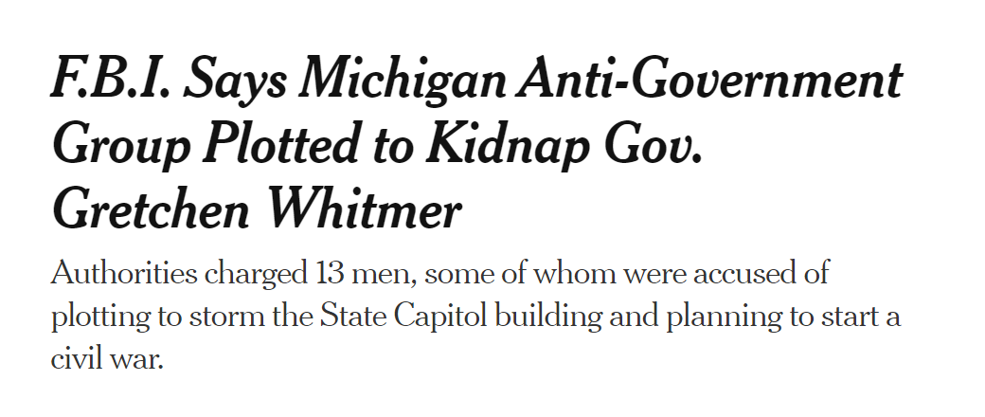
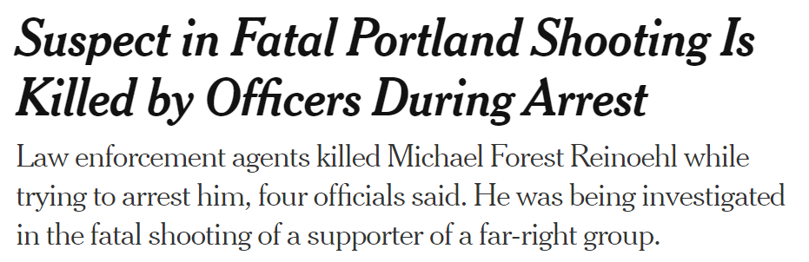
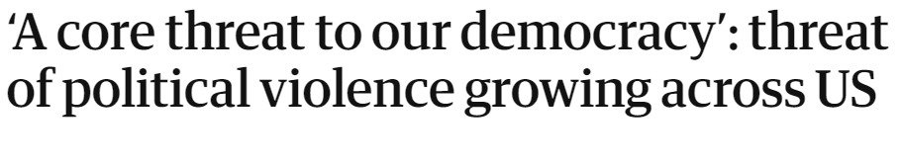
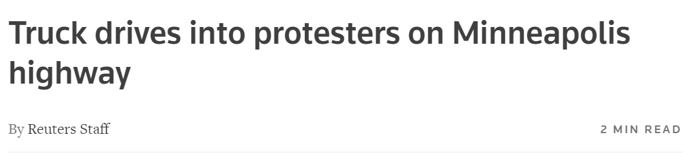
Violence

Slide 10
Project Scope
Collect Twitter Data
Conduct Sentiment Analysis
Visualize How Different Topics Gain Popularity
Create a Network Graph

Slide 11
Network Analysis

Slide 12
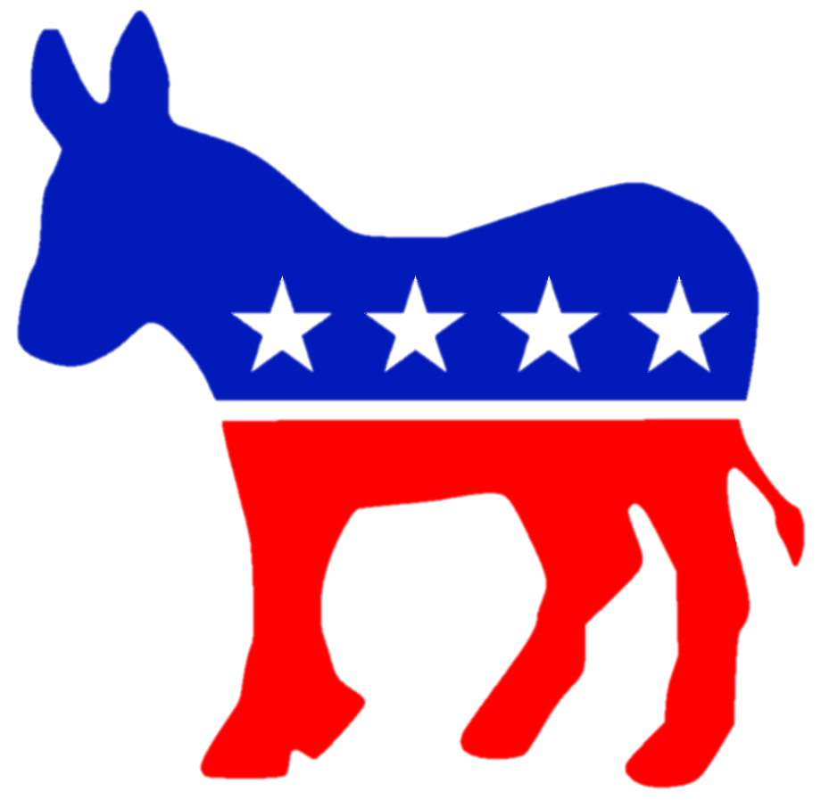
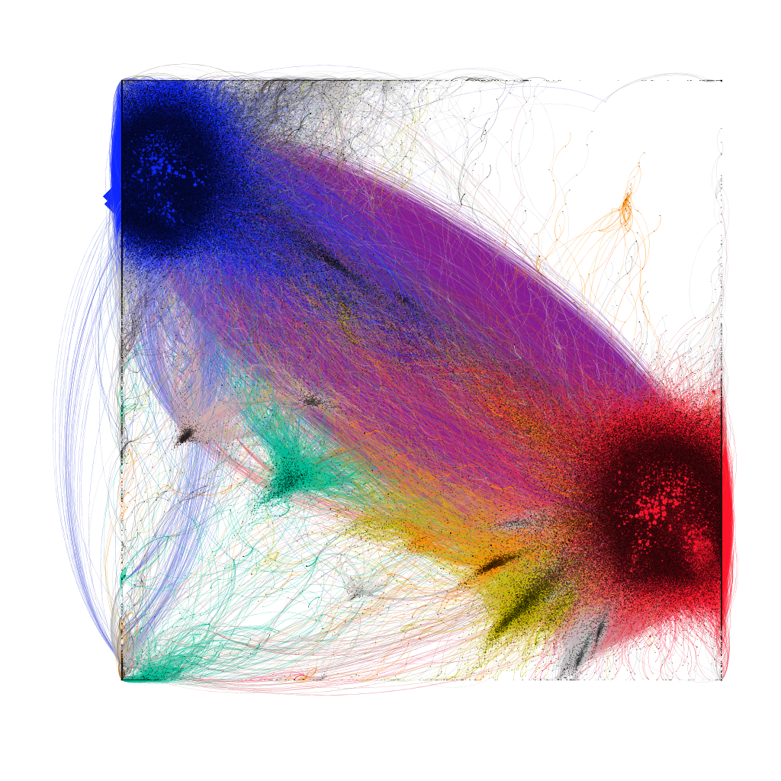
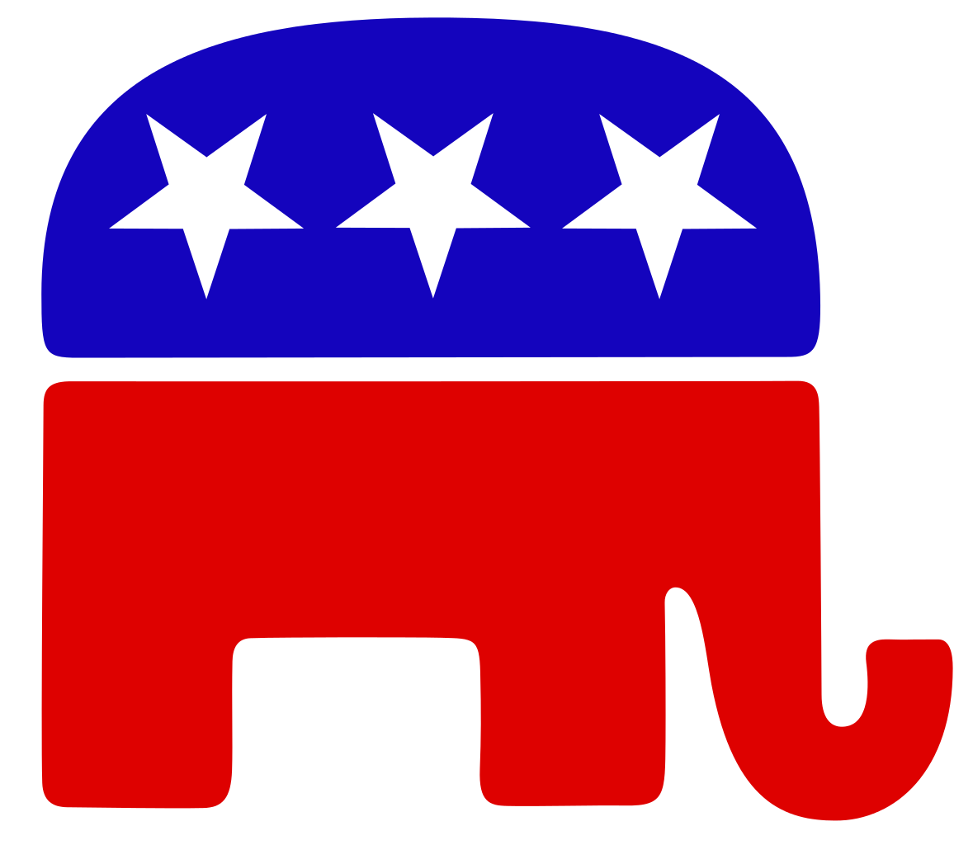
2020 Network Graph → Echo Chambers

Slide 13
Sentiment Analysis

Slide 14
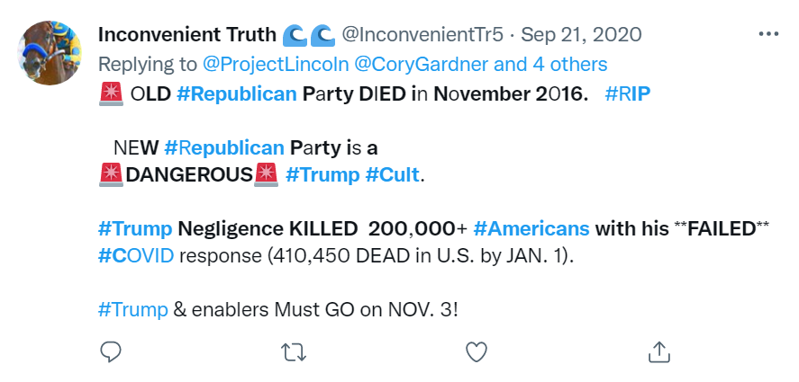
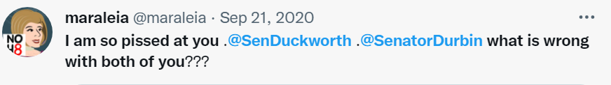
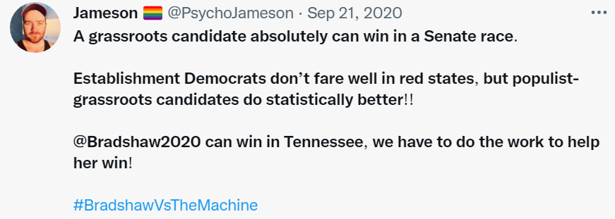
Sentiment Scoring
Each tweet receives a sentiment score on a scale from -1 (very negative) to 1 (very positive)
Sentiment Score: -0.88
Sentiment Score: -0.95
Sentiment Score: 0.97

Slide 15
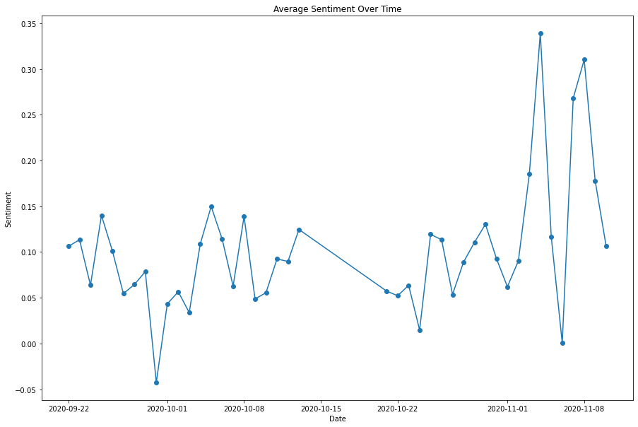
Average Sentiment Leading up to Elections

Slide 16
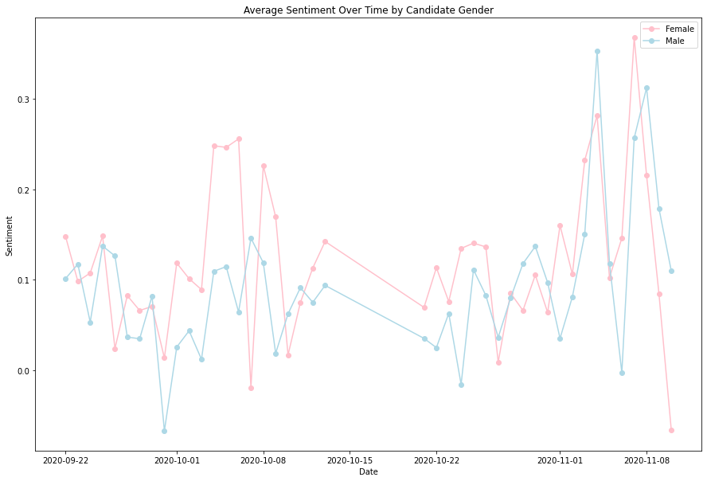
Average Sentiment by Candidate Gender

Slide 17
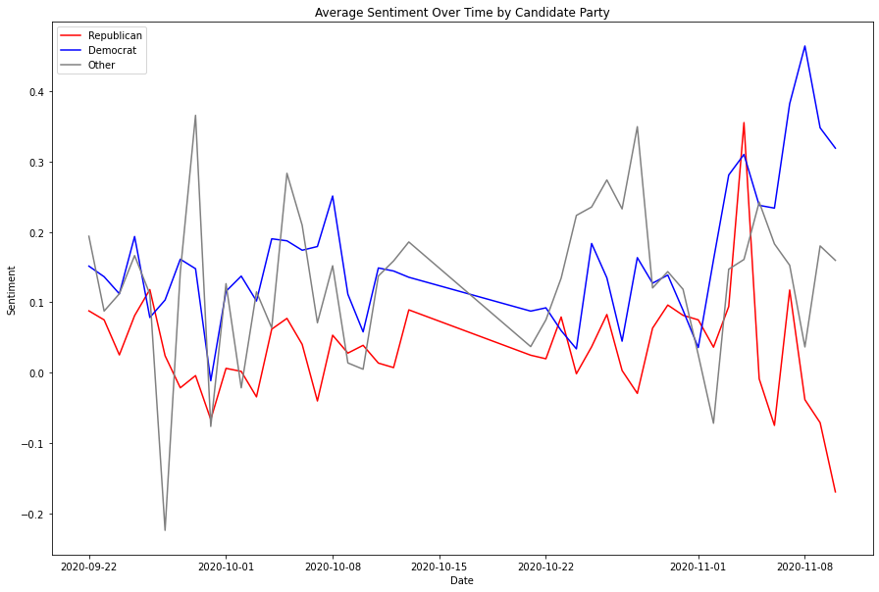
Average Sentiment by Candidate Party

Slide 18
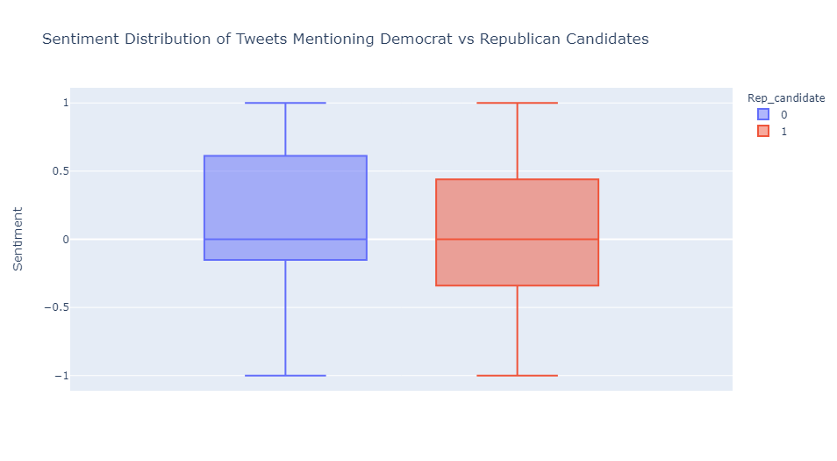
Distribution of Sentiment by Party

Slide 19
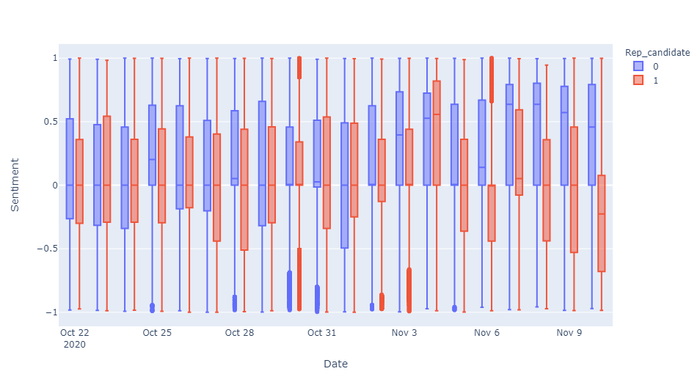
Distribution of Sentiment by Date and Party

Slide 20
Topics Spreading on Twitter

Slide 21
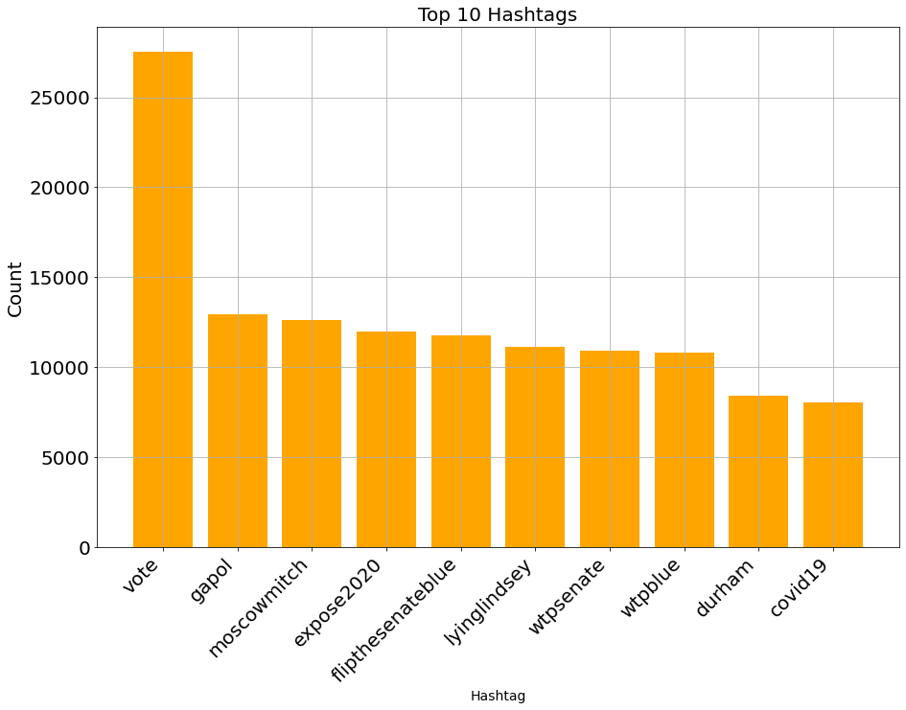
Top 10 Hashtags

Slide 22
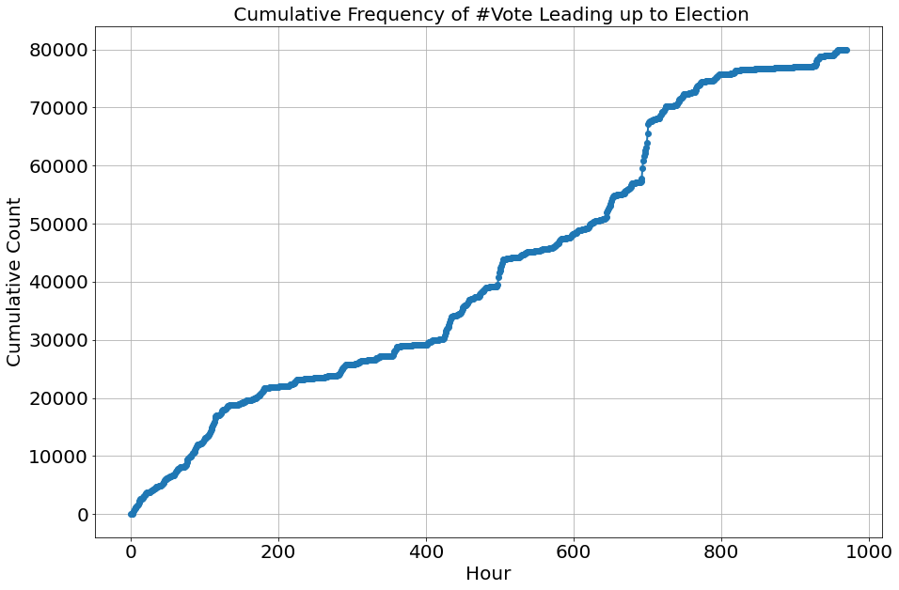
#Vote - Baseline
Here we observe a neutral hashtag, #vote, to see how more polarized topics compare.
We see linear growth in the count of this hashtag.

Slide 23
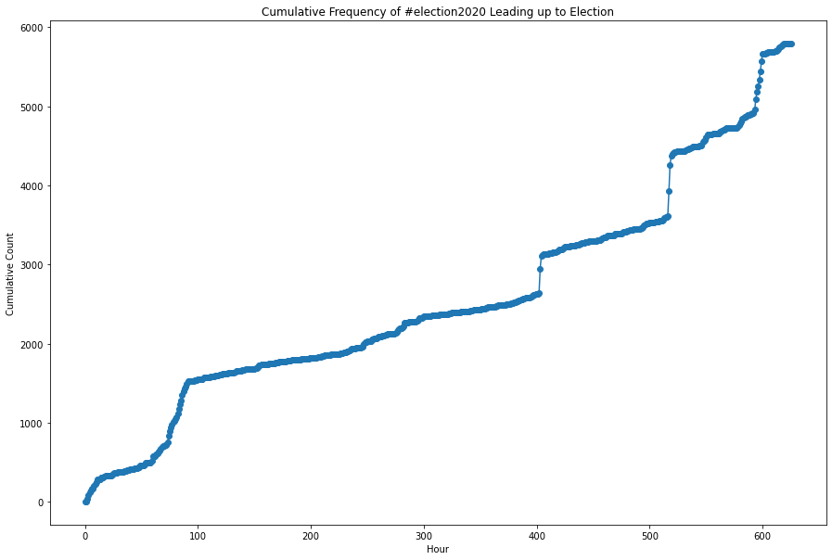
#Election2020 - Baseline
We see the same linear trend for this neutral topic.

Slide 24

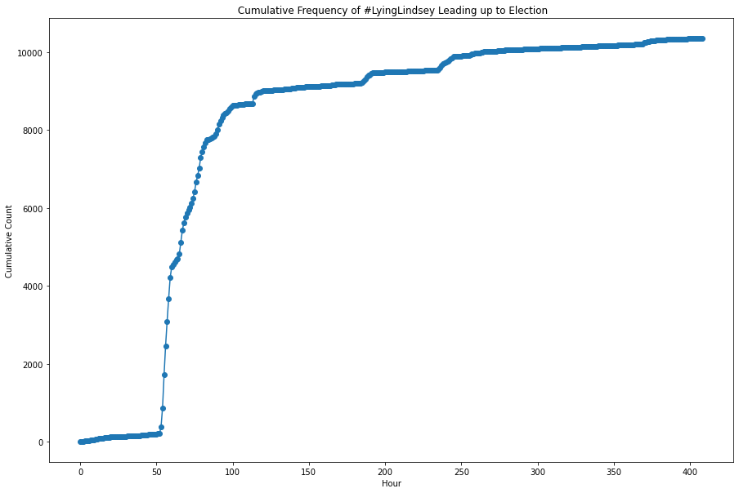
Lying Lindsey
Lindsey had said he would not support the nomination of a Supreme Court justice in the final year of Trump’s term.
This topic’s popularity shows logistic growth that spreads more rapidly
In September of 2020, he changed his view which upset Democrats.

Slide 25
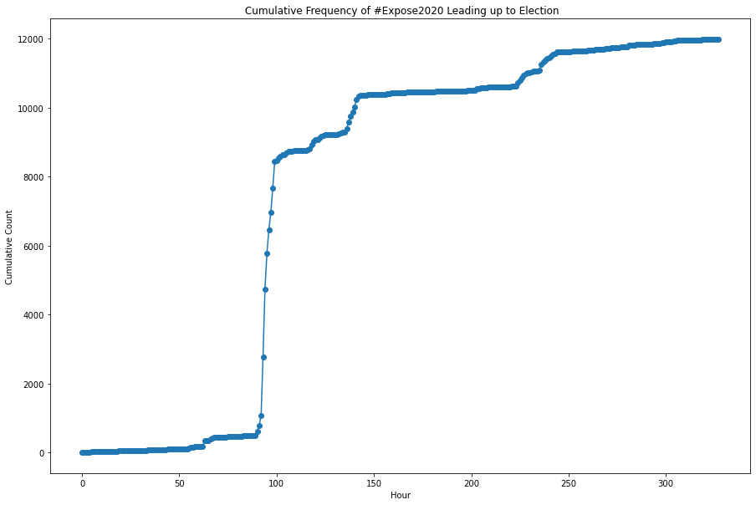
Expose 2020
Project Veritas, a far-right activist group, who posts videos (often edited) that “expose” the government gained traction during the campaigns.
A similar pattern is seen, with the topic spreading rapidly then leveling off.

Slide 26
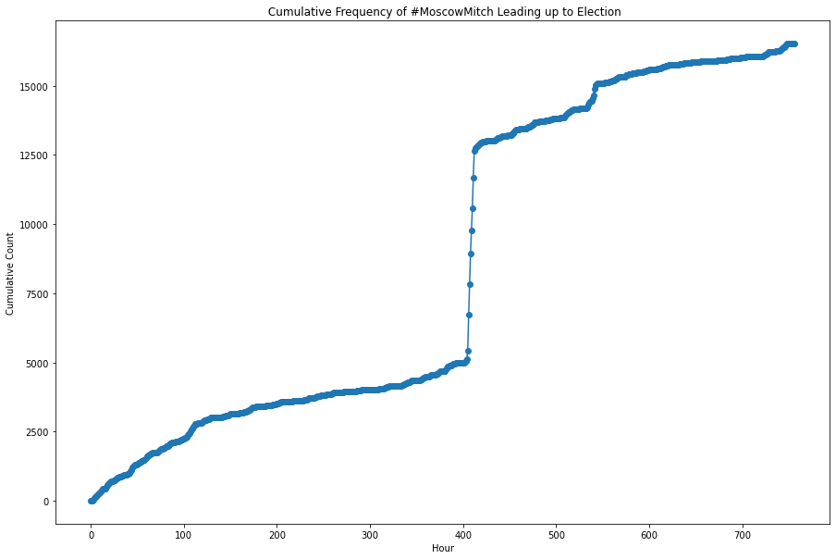
Moscow Mitch
McConnell, minority leader of the senate, was accused of blocking stronger election security measures.
A similar pattern is seen here, showing that a polarized topic gains traction quicker than a neutral one.

Slide 27
What Does This Tell Us?
Network analysis shows two echo chambers split by party affiliation on Twitter
As elections near, sentiment becomes more varied.
Polarized topics gain traction faster than neutral ones on Twitter.

Slide 28
What Does This Tell Us?
Network analysis shows two echo chambers split by party affiliation on Twitter.
As elections near, sentiment becomes more varied.
Polarized topics gain traction faster than neutral ones on Twitter.
Political discussion on Twitter is contributing to the growing polarization in the US.

Slide 29
Conclusions
The network graph shows two distinct communities interacting almost exclusively with one another.
Spikes and dips in sentiment close to the election suggest polarity increases close to this day.
Popular negative topics spread extremely rapidly on twitter, showing their infectious nature.

Slide 30
Questions?

